Slide 1

The Relationship Between Demographics & Violent Crime in the US
The Relationship Between Demographics & Violent Crime in the US
The Relationship Between Demographics & Violent crime in the US
Temidayo Akinsanya
Cheryl Johnson
Johns Hopkins University Data Analytics Bootcamp
Project 1
Temidayo Akinsanya
Cheryl Johnson

Slide 2
Project Description
The Effect of Demographics on Violent Crime Rates in the US
Members: Temidayo Akinsanya and Cheryl Johnson
This project seeks to examine the relationship between demographics and violent crime in cities across the United States. We will do this by comparing the cities with the highest and lowest crime rates per capita in each state.
The Relationship Between Demographics & Violent crime in the US
Temidayo Akinsanya
Cheryl Johnson

Slide 3
Hypothesis
There is a relationship between demographics and violent crime in the US.
The comparison will examine several data points:
> Average Income > Race
> Unemployment Rate > Marital Status
> Education Level > School Enrollment
> Population
NULL Hypothesis—There is no relationship between demographics and violent crime in the US.
The Relationship Between Demographics & Violent crime in the US
Temidayo Akinsanya
Cheryl Johnson

Slide 4
Research Questions
Is there a correlation between the level of violent crime and the presence of lack thereof of living arrangements with higher proportion of married spouses?
Can the rate of school enrollment predict the level of violent crime rate in America cities?
Is violent crime more likely to be higher in cities with a particular race?
Is there a correlation between poverty rate and violent crime rate?
Is there a correlation between unemployment and violent crime rate?
The Relationship Between Demographics & Violent crime in the US
Temidayo Akinsanya
Cheryl Johnson

Slide 5


Conclusions (continued)
“The “suburban housewife” will be voting for me. They want safety & are thrilled that I ended the long running program where low income housing would invade their neighborhood. Biden would reinstall it, in a bigger form, with Corey Booker in charge!”
President Donald Trump – 8/12/20
“Maybe this has to do with the fact that people aren't paying their rent & are scared to pay their rent & so they go out & they need to feed their child & they don't have money so... they feel like they either need to shoplift some bread or go hungry."
Rep. Alexandria Ocasio-Cortez – 7/12/20
The Relationship Between Demographics & Violent crime in the US
Temidayo Akinsanya
Cheryl Johnson

Slide 6
Data Sources
Datasets Used:
FBI Uniform Crime Reporting Program Database
American Community Survey: Five-Year Data (US Census database)
Describe data within data sources to be used
Utilized only Violent Crimes from FBI crimes database
Census had much more demographic
Describe challenges with
Census data—used API
FBI is in Excel because FBI does not have API on state level
The Relationship Between Demographics & Violent crime in the US
Temidayo Akinsanya
Cheryl Johnson
Notes:
[see Memo 2 Page 4 -5 for discussion]

Slide 7
Data Exploration & Cleanup
Census Data
Renamed the columns from “Census Key” to make them readable in meaningful titles
Split the city and state into two columns
Eliminated characters in the city names to align with the city names in the FBI data
FBI Data
Included the state in every row so that merge with Census data would work
Extracted only the violent crime fields
Removed characters from the state and city names to align with city and state in Census data
Created a new column with crime rate per capita
Extracted the data for the highest crime rate city and the lowest crime rate city within each state
Merge
Merged Census demographic data with the FBI crime data on the city and state fields
The Relationship Between Demographics & Violent crime in the US
Temidayo Akinsanya
Cheryl Johnson

Slide 8
Data Analysis
We created charts, graphs, and statistics of our demographic data to see whether we observed any obvious trends or differences that might influence our inquiry
We created scatter plots for the three demographic areas that produced single data points: Income, Unemployment, Population
We also generated summary statistics and correlation analysis tables for those three demographic areas: Income, Unemployment, Population
We created stacked bar charts for the four demographic areas that produced multiple data points: Marital Status, Race, School Enrollment, and Education Level
For the stacked bar charts, we converted the actual numbers to relative numbers (percentages of the whole) in order to chart them meaningfully
The Relationship Between Demographics & Violent crime in the US
Temidayo Akinsanya
Cheryl Johnson

Slide 9
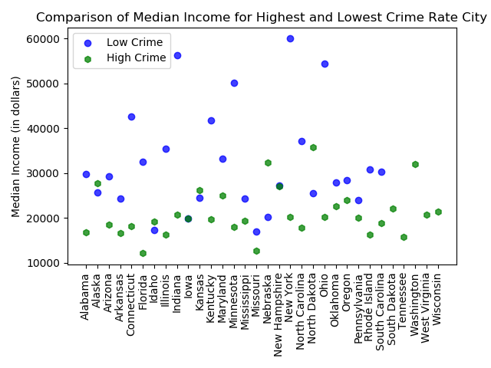
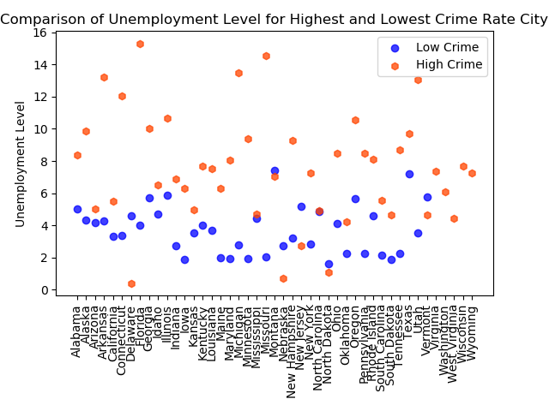
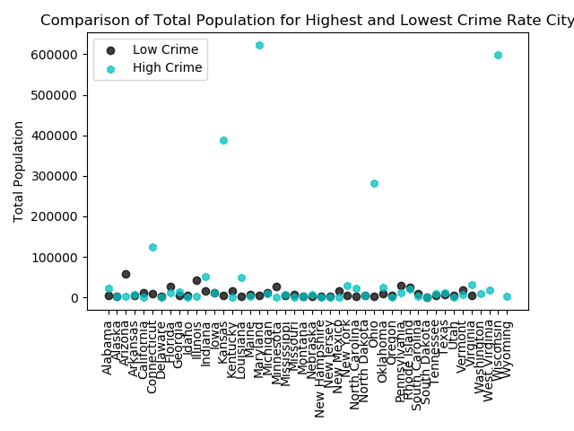
Analysis: Income, Unemployment, Population
We created scatter plots of Income, Unemployment, and Population demographics for the Low Violent Crime Rate locations and the High Violent Crime Rate locations to see whether we observed any obvious trends or differences that might influence our inquiry.
The Relationship Between Demographics & Violent crime in the US
Temidayo Akinsanya
Cheryl Johnson

Slide 10
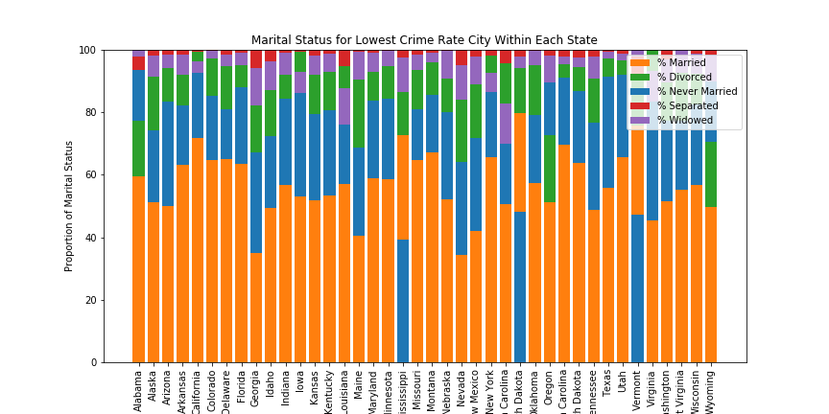
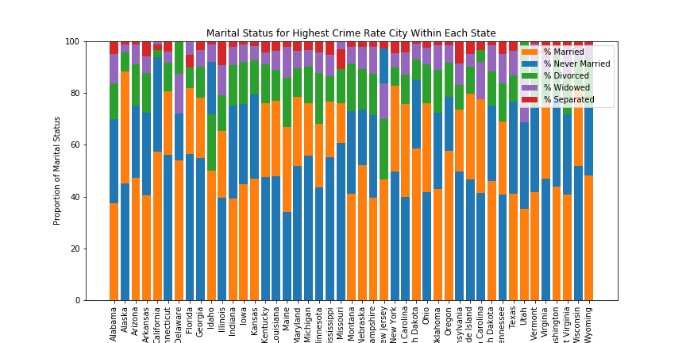
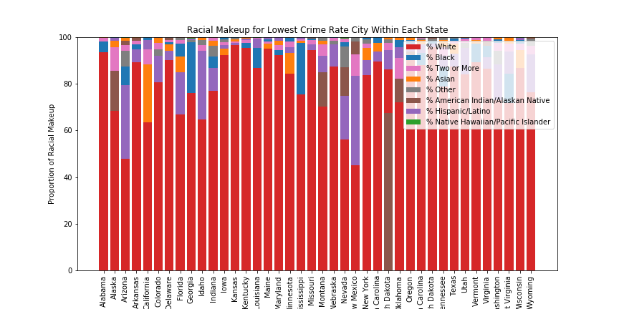
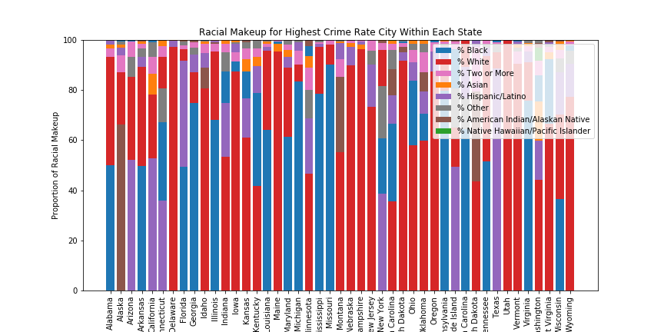
Analysis: Marital Status, Race
We created stacked bar charts of School Enrollment and Education Level demographics for the Low Violent Crime Rate locations and the High Violent Crime Rate locations to see whether we observed any obvious trends or differences that might influence our inquiry.
The Relationship Between Demographics & Violent crime in the US
Temidayo Akinsanya
Cheryl Johnson
(low violent crime) Marital Status (high violent crime)
(low violent crime) Race (high violent crime)

Slide 11
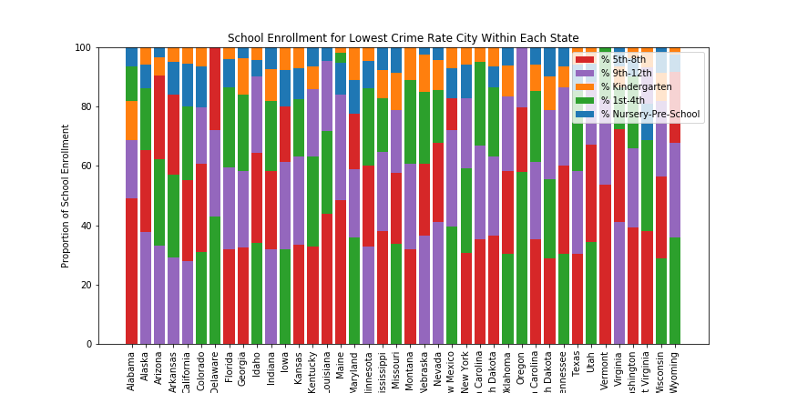
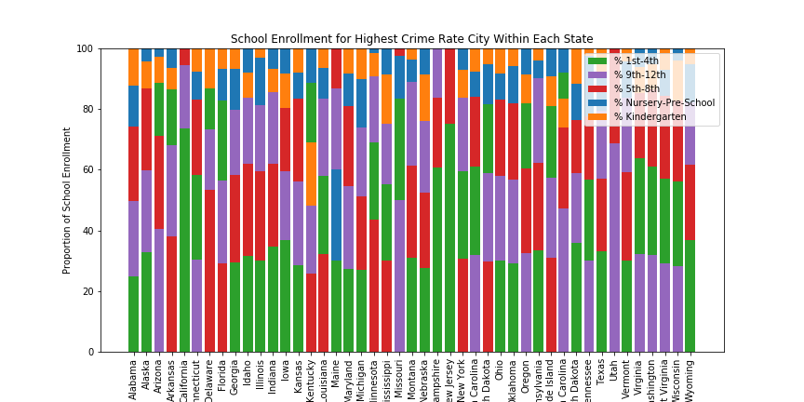
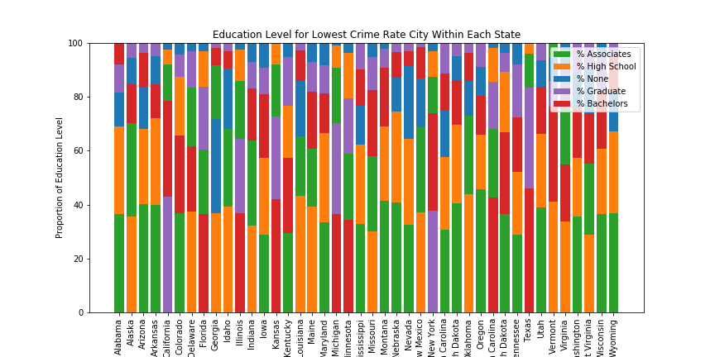
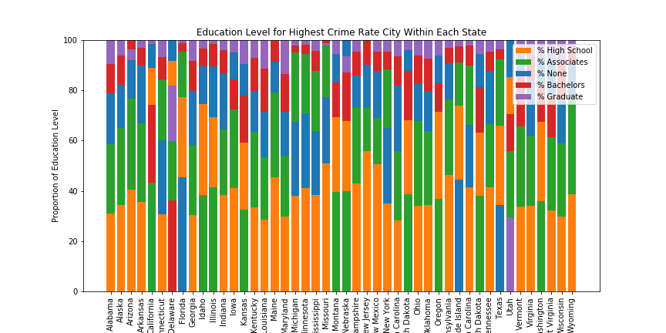
Analysis: School Enrollment, Education Level
We created stacked bar charts of School Enrollment and Education Level demographics for the Low Violent Crime Rate locations and the High Violent Crime Rate locations to see whether we observed any obvious trends or differences that might influence our inquiry.
The Relationship Between Demographics & Violent crime in the US
Temidayo Akinsanya
Cheryl Johnson
(low violent crime) School Enrollment (high violent crime)
(low violent crime) Education Level (high violent crime)

Slide 12
Data Analysis (continued)
Our previous observations had been done on larger data sets, keeping Low Violent Crime Rate data separate from High Violent Crime Rate data.
Our next step was to summarize the Low Violent Crime Rate data and the High Violent Crime Rate data
We then worked with the two sets of summary data to make our final observations and conclusions.
The Relationship Between Demographics & Violent crime in the US
Temidayo Akinsanya
Cheryl Johnson

Slide 13
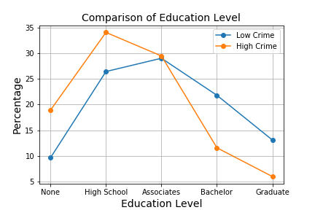
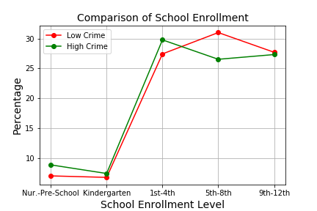
Observations: Education Level, School Enrollment
Education Level
Highest level of education in low violent crime locations is an Associates Degree
Highest level of education in high violent crime locations is an High School Degree
Both high violent crime and low violent crime locations had the same percentage of residents with Associates Degree as highest level of education
Low Violent Crime locations had more than twice the percentage of Graduate degree completion than High Violent Crime locations
The Relationship Between Demographics & Violent crime in the US
Temidayo Akinsanya
Cheryl Johnson
Education Level
Low Violent Crime locations and High Violent Crime Locations have the same enrollment in all level of education except for 5th – 8th grade
High Violent Crime locations had fewer students enrolled in 5th-8th grades, when compared to 1st-4th grades
Low Violent Crime locations had fewer students enrolled in 9th-12th grades, when compared to 5th-8th grades

Slide 14
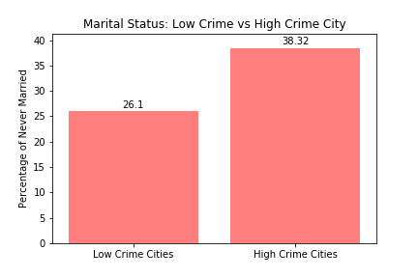
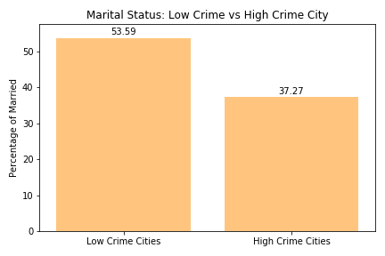
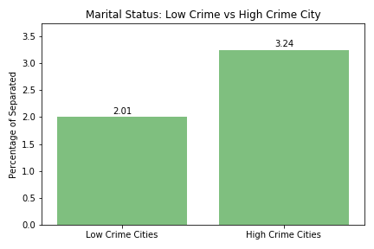
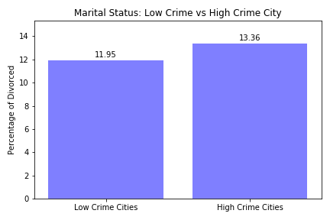
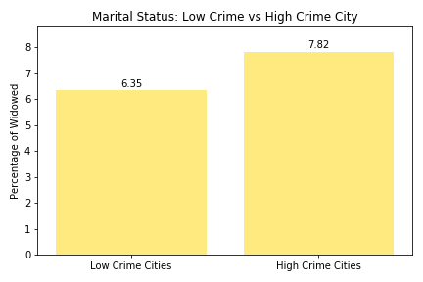
Observations: Marital Status
For low violent crime locations, the largest Marital Status category is “Married” at nearly 54% (compare to high violent crime locations, where 37% are classified as “Married”)
For high violent crime locations, the largest Marital Status category is “Never Married” at 38% (compare to low violent crime locations, where 26% are classified as “Never Married”)
Between low violent crime and high violent crime locations, the Marital Status categories with little difference are “Separated” (2% vs 3%), “Divorced” (12% vs 13%), and “Widowed” (6% vs. 8%)
The Relationship Between Demographics & Violent crime in the US
Temidayo Akinsanya
Cheryl Johnson

Slide 15
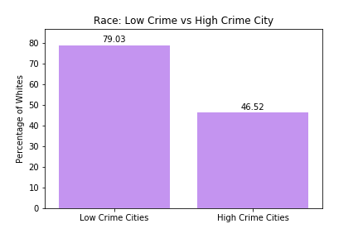
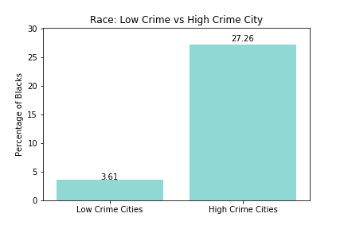
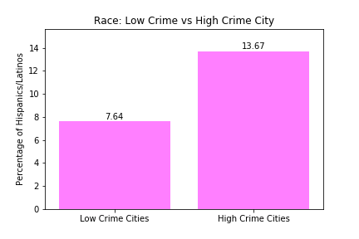
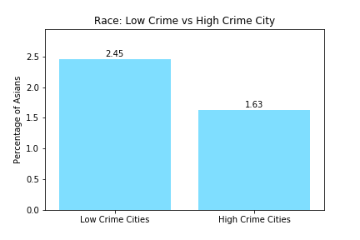
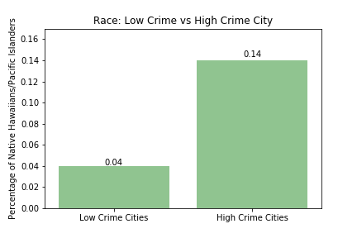
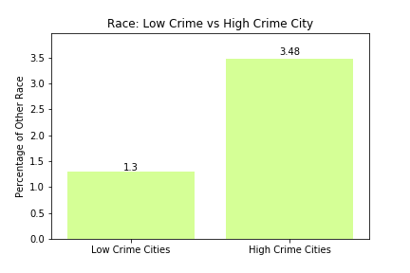
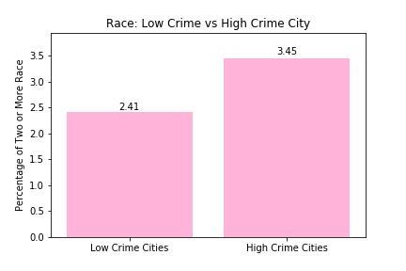
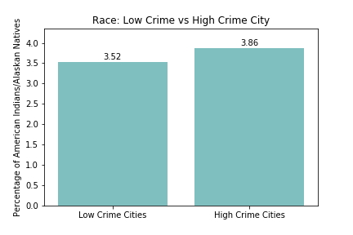
Observations: Race
“White” is the largest race represented both for low violent crime and high violent crime cities
“White” and “Asian” are the only two race to have higher proportions in low violent crime locations than in high violent crime locations
“Black” race had the largest percentage increase between low violent crime locations (3.6%) and high violent crime locations (27%): 655% increase
“Hispanic/Latino” category had a large percentage increase between low crime locations (7.6%) and high crime locations (13.7%): 79% increase
The Relationship Between Demographics & Violent crime in the US
Temidayo Akinsanya
Cheryl Johnson

Slide 16
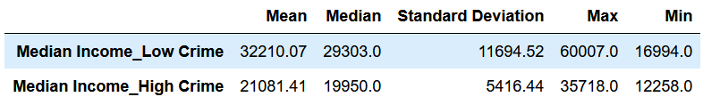
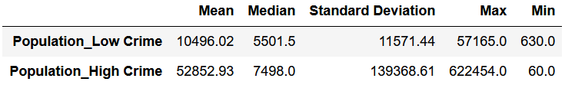
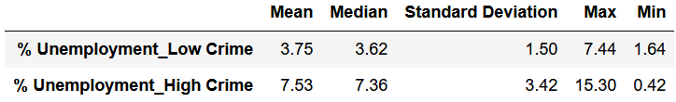
Observations: Statistical Charts
Income:
There is a greater diversity of median income for low crime cities than for high crime cities
Population
The difference in median population for low crime and high crime cities did not appear to be statistically significant
Unemployment
High crime cities have nearly 100% higher unemployment rate than low crime cities.
The Relationship Between Demographics & Violent crime in the US
Temidayo Akinsanya
Cheryl Johnson

Slide 17
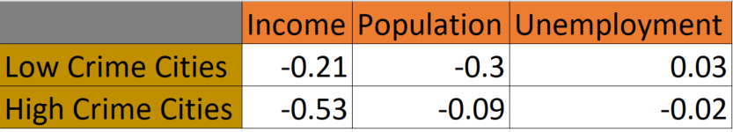
Observations: Correlation Analysis
Income
For Income, there is inverse correlation between crime and income; the correlation is stronger for high-crime cities
however, because the correlation is much smaller for low-crime cities, it tells us that low income does not automatically equal high crime.
Population & Unemployment – no correlation with Violent Crime
The Relationship Between Demographics & Violent crime in the US
Temidayo Akinsanya
Cheryl Johnson

Slide 18
Conclusions
Based on our Analysis, our findings are:
6) Income The highest violent crime locations have on average lower median income than the lowest violent crime locations. Although there is an inverse correlation between median income and violent crime in the highest violent crime locations, low income itself does not mean high violent crime as the inverse correlaton is 25% with the lowest violent crime locations. Since there are indeed lowest violent crime locations with median income thta is lower than some highest violent crime locations, low income on its own can not be attributed to violent crime.
The Relationship Between Demographics & Violent crime in the US
Temidayo Akinsanya
Cheryl Johnson

Slide 19
Conclusions (continued)
Marital Status
The lowest violent crime locations had more married residents than non married residents while the opposite is true for the highest crime violent locations. It appears that marriage seems to be the have a significant impact in the level of violent crime of a location.
Encouraging healthy and stable marriages can perhaps yield tangible benefits in efforts to reduce violent crimes in cities across the nation.
Race
There are more minorities in the highest violent crime locations than in the lowest violent crime locations. The lowest violent crime locations are over 75% White.
The Relationship Between Demographics & Violent crime in the US
Temidayo Akinsanya
Cheryl Johnson

Slide 20
Conclusions (continued)
Education
There is more advanced education in the lowest violent crime locations than the highest violent crime locations.
There is a steep decline of 60% from Associates to Bachelors degree holders in the highest violent crime cities.
This shows that improving education attainment or equipping residents with trade skills can contribute to them adding value to the workforce thereby lowering unemployment and possibly violent crime.
School Enrollment
Enrollment in N-12 education has no relationship with the level of violent crime a location has. However, perhaps the quality of education may tell a different story and possibly contribute to the lack of education beyond an Associates degree, as observed above.
The Relationship Between Demographics & Violent crime in the US
Temidayo Akinsanya
Cheryl Johnson

Slide 21
Conclusions (continued)
Unemployment
The lowest violent crime locations on average have an unemployment rate that is within the Federal Reserve's range of ideal unemployment rate of 3.5%-4.5%; while the highest violent crime rate locations are on average, 3% higher than the ideal.
While the unemployment rate is higher for the highest crime rate locations, it does not have a correlation to violent crime because there are indeed ideal unemployment locations with the highest violent crime as there are above ideal unemployment locations with the lowest violent crime.
Income
The highest violent crime locations have on average lower median income than the lowest violent crime locations.
Although there is an inverse correlation between median income and violent crime in the highest violent crime locations, low income itself does not mean high violent crime as the inverse correlation is more than 30% lower than the lowest violent crime locations.
Since there are indeed lowest violent crime locations with median income that is lower than some highest violent crime locations, low income on its own can not be attributed to violent crime.
The Relationship Between Demographics & Violent crime in the US
Temidayo Akinsanya
Cheryl Johnson

Slide 22
Conclusions (continued)
Population
The highest violent crime locations have very high populations
The median for the lowest and highest crime populations does not appear to be statistically significant.
In fact, the lowest population for the highest violent locations is lower than that of the lowest violent crime location.
Thus, Population alone cannot be an indicator of nor does it have correlation with violent crime.
There does appear to be an inverse correlation in the lowest crime locations but it is not conclusive given the populations in the highest crime locations.
Biggest Surprise: The marriage data
Biggest Confusion: The income data
The Relationship Between Demographics & Violent crime in the US
Temidayo Akinsanya
Cheryl Johnson

